Slide 1
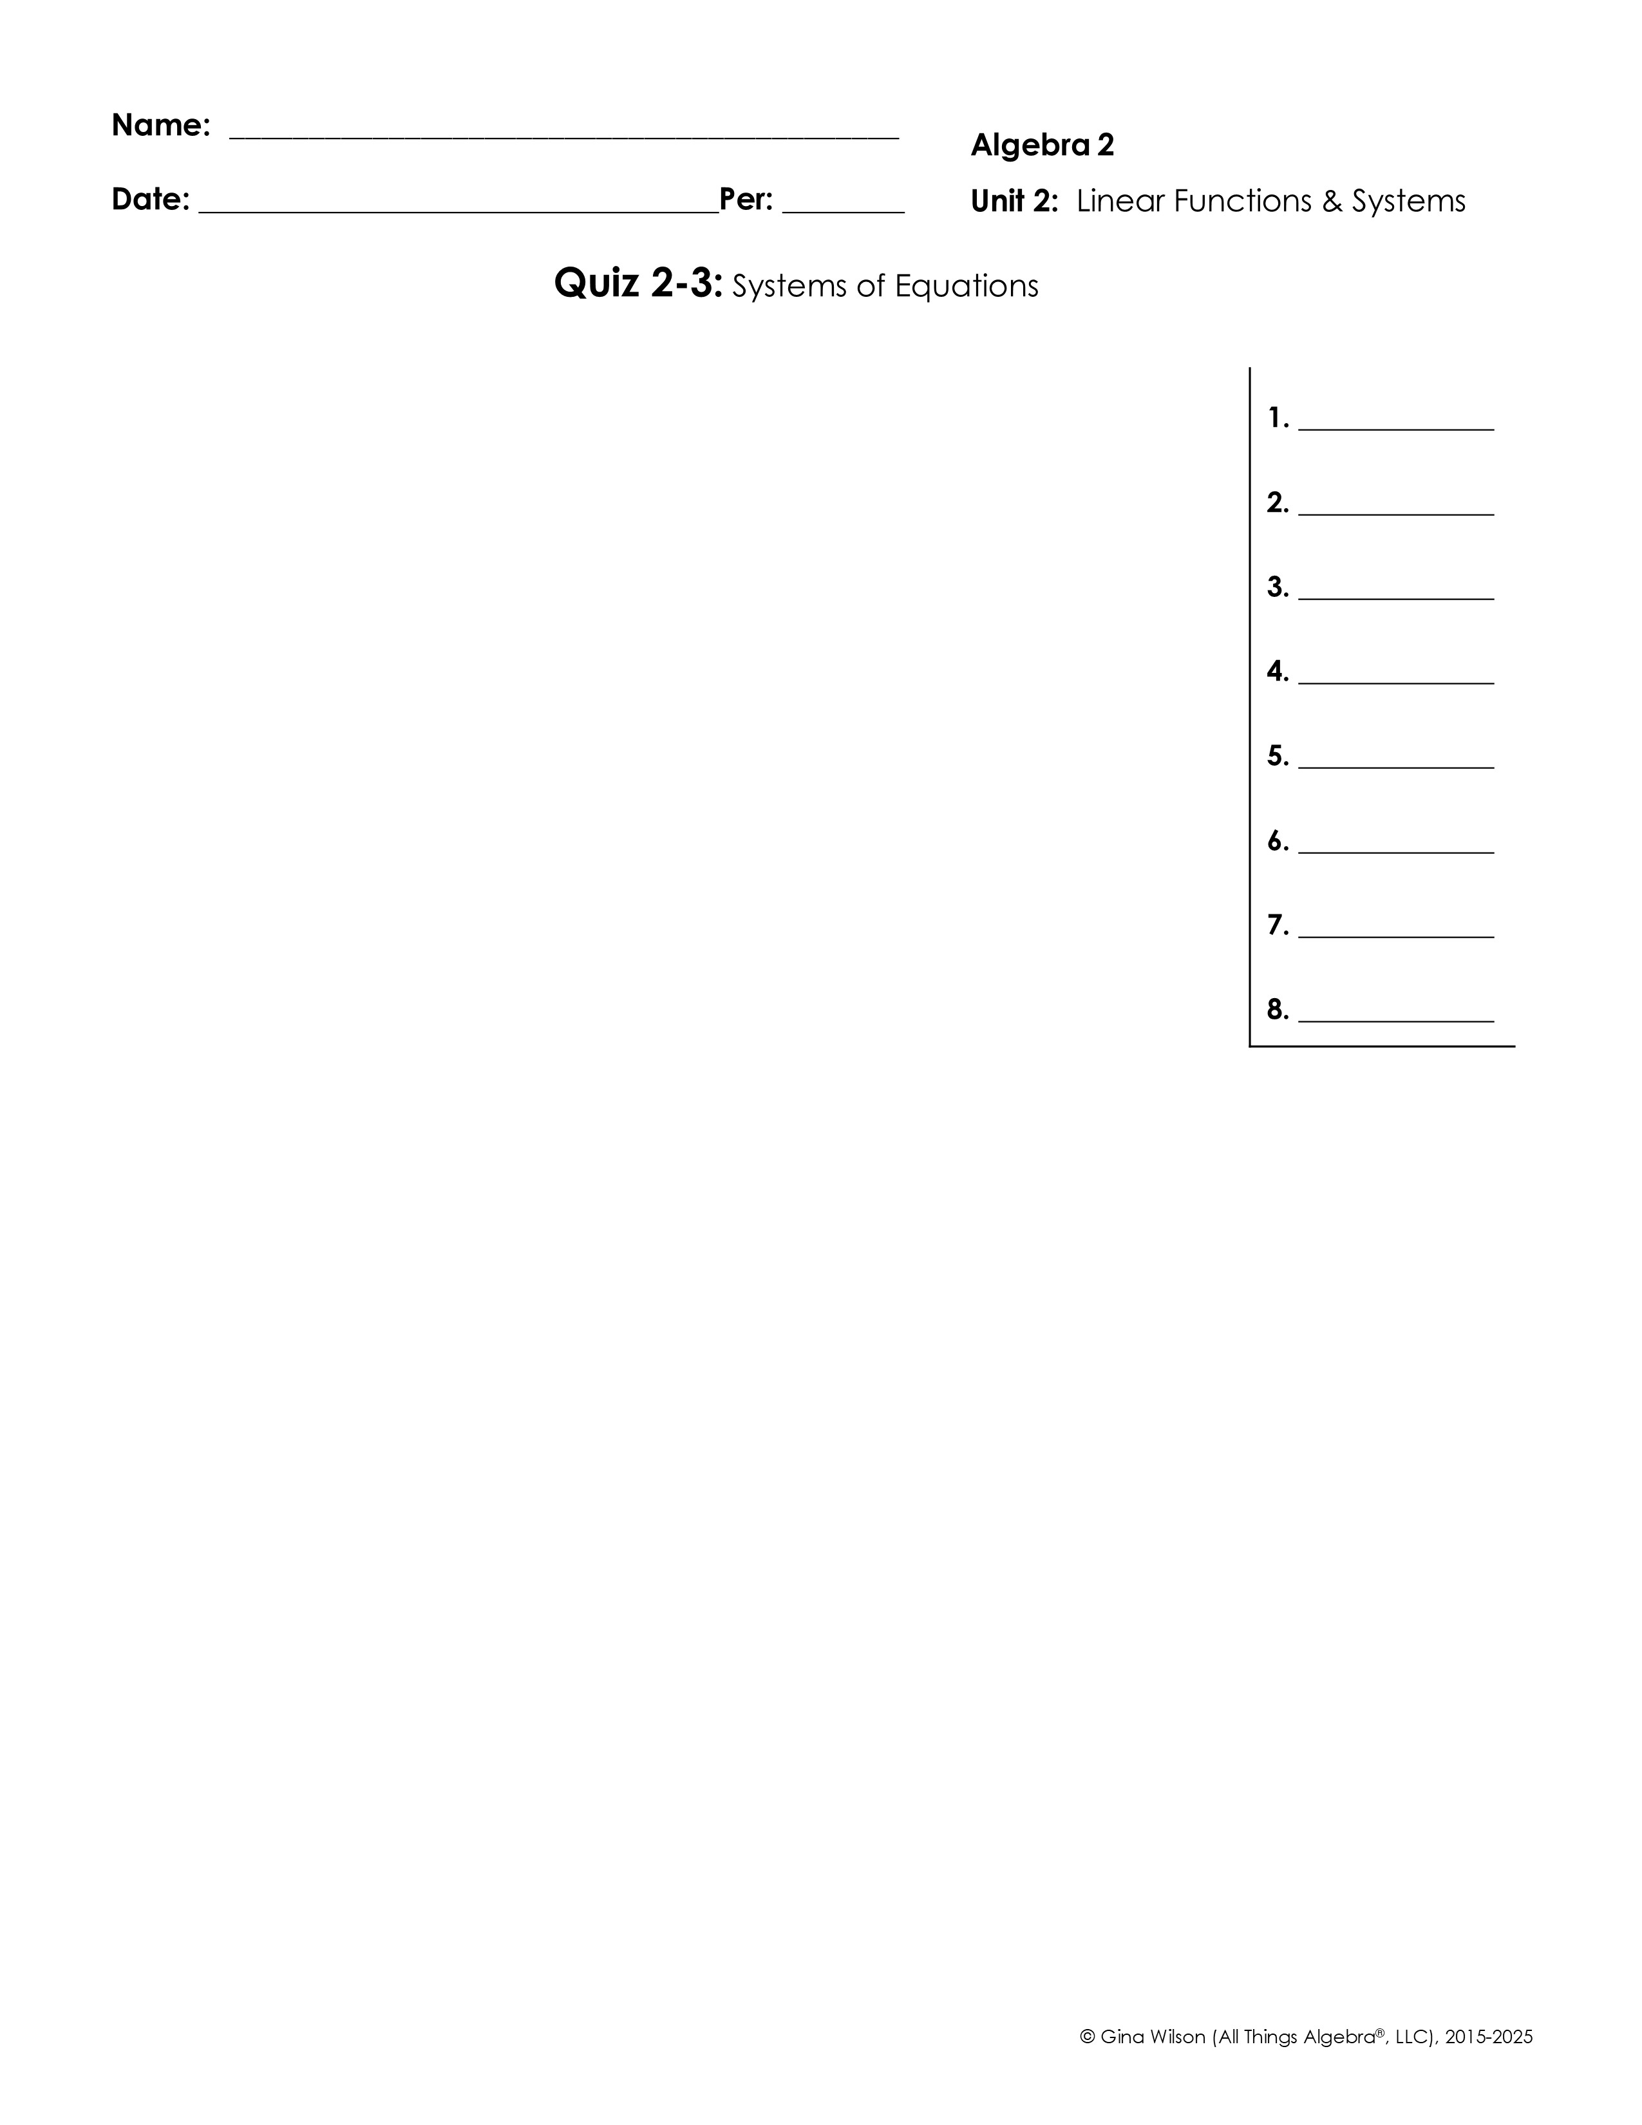
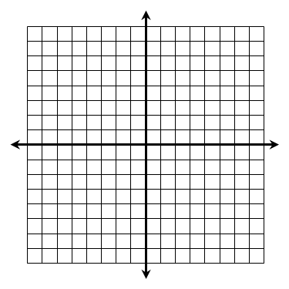
For questions 1-2, solve the system by graphing.
1.
2.
For questions 3-4, solve the system using the substitution method.
3.
4.
For questions 5-8, solve the system using the elimination method.
5.
6.
7.
8.

Slide 2
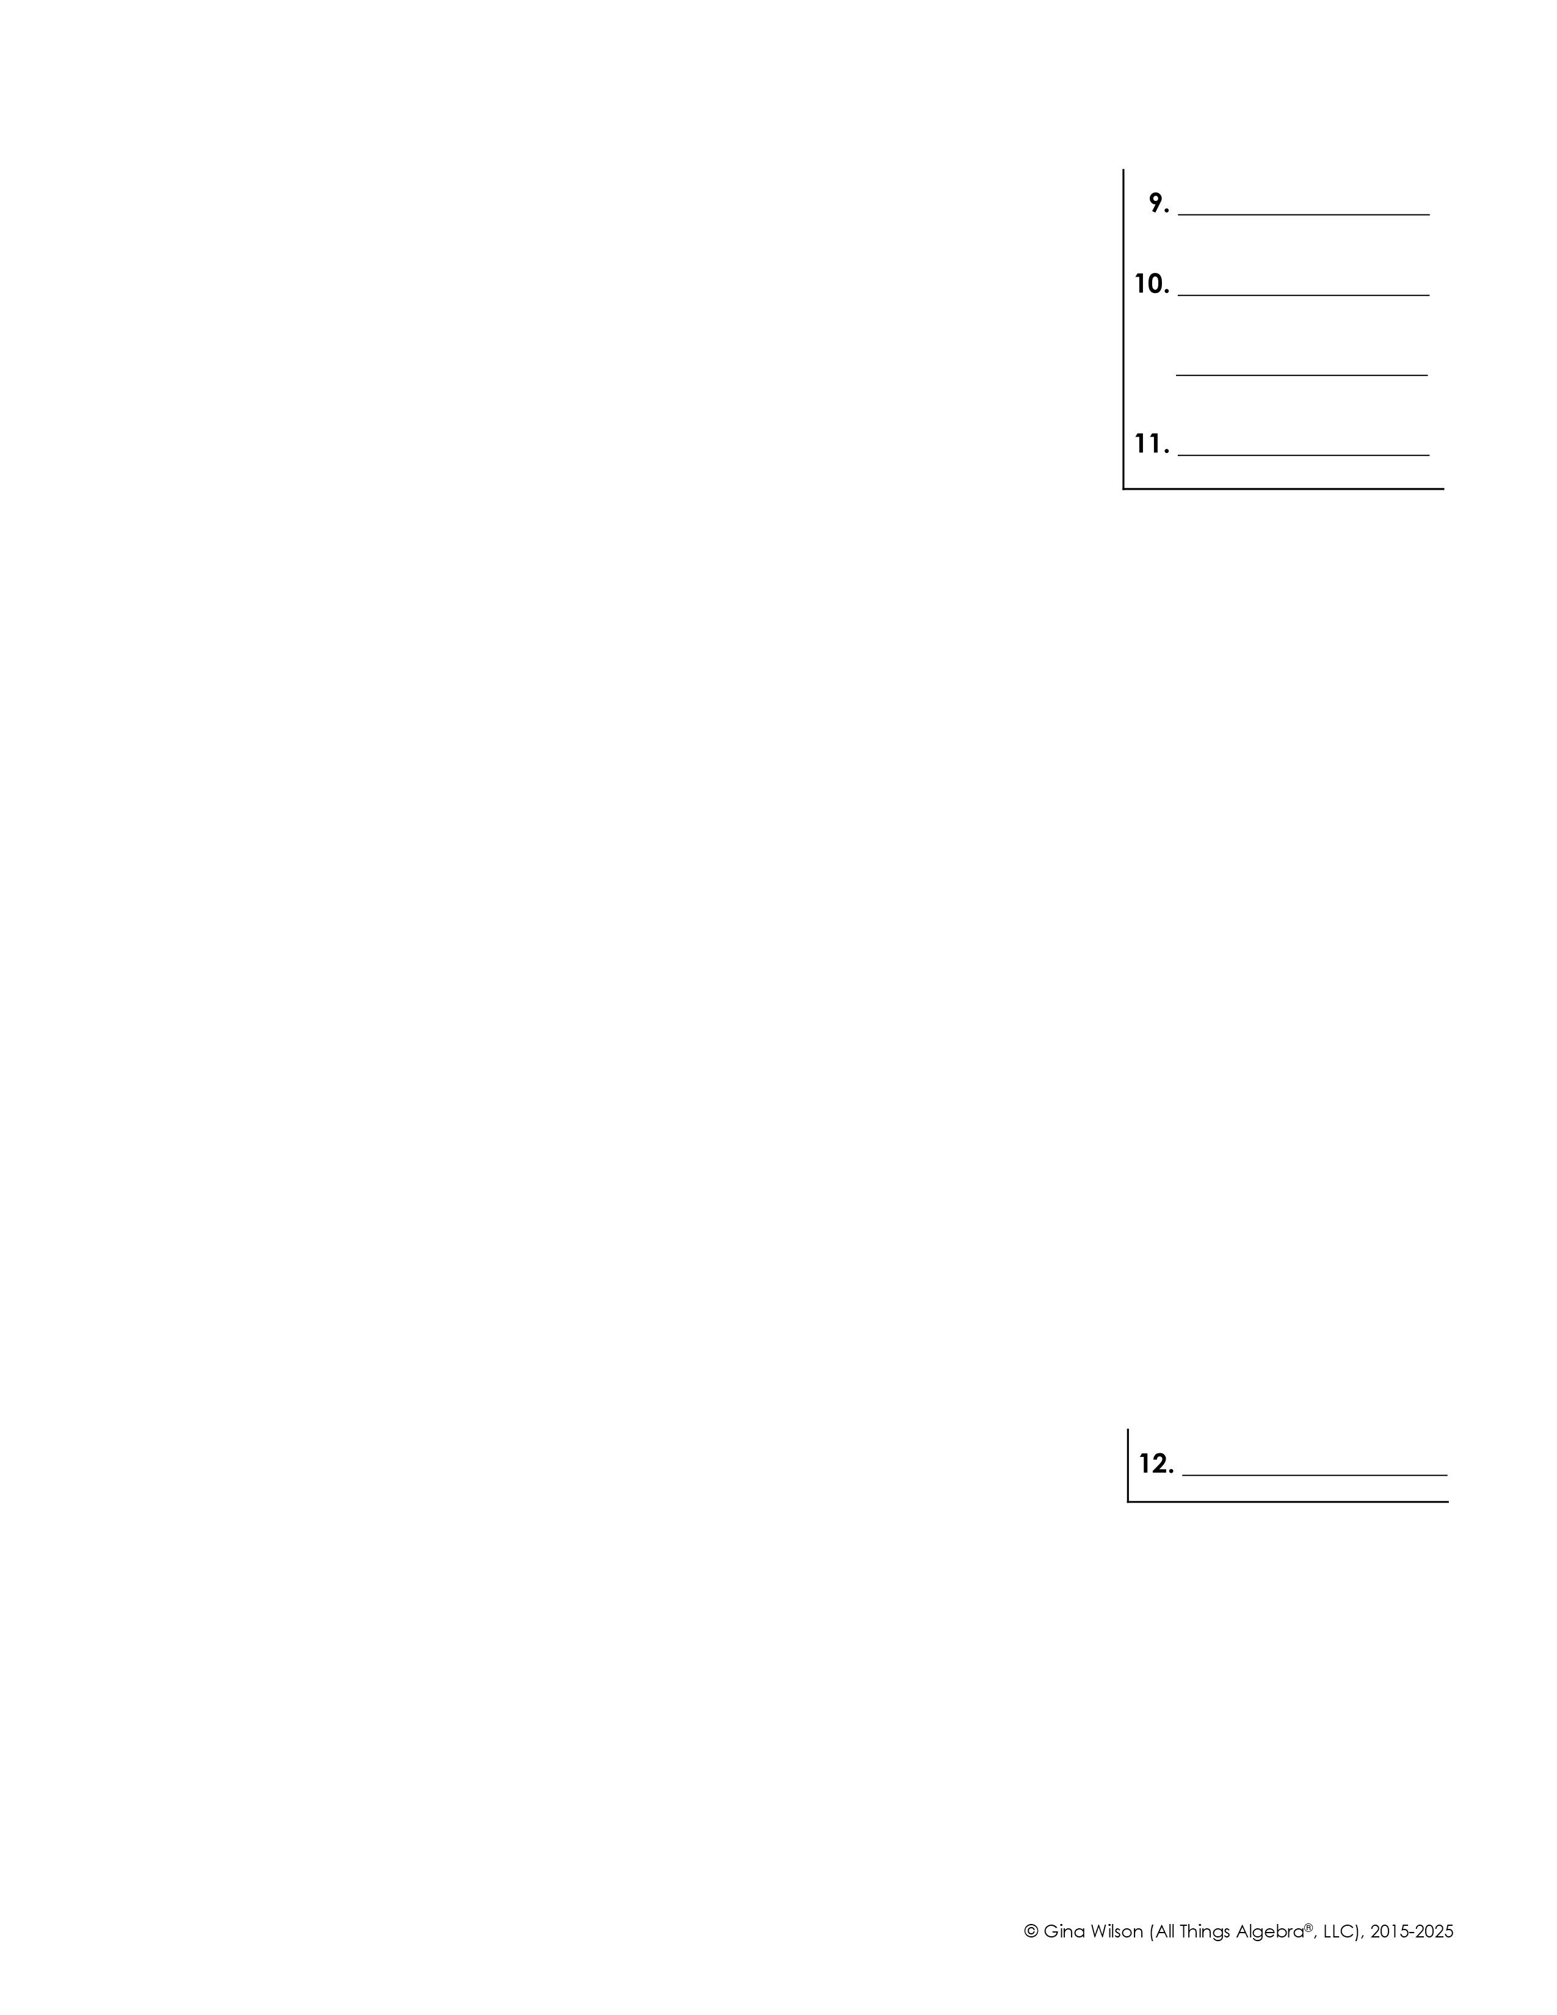
For questions 9-11, solve using a system of equations with your method of choice.
9. Casey bought a 15.4-pound turkey and an 11.6-pound ham for Thanksgiving and paid $38.51. Her friend Jane bought a 10.2-pound turkey and a 7.3-pound ham from the same store and paid $24.84. Find the cost per pound of turkey.
10. Owen has a collection of nickels and quarters worth $8.10. If the nickels were quarters and the quarters were nickels, the value would be $17.70. How many of each type of coin does Owen have?
11. Michelle invested $12,000 in stocks and bonds, paying 4.8% and 7% annual interest, respectively. If the total interest earned for the year was $763, how much was invested in stocks?
Solve the system of three variables below.
12.

